Slide 1

● Monmouth University Scholarship Week 2026
PRESENTED BY
Building Leaders from the Ground Up
Bingjun Li
M.S.Ed.
Graduate Assistant
— MENTORED BY —
Dr. Clifford
Acting Dean, SNHS
How a Graduate Assistant Designed, Launched, and Grew the SNHS Student Ambassador Program
1 / 17

Slide 2
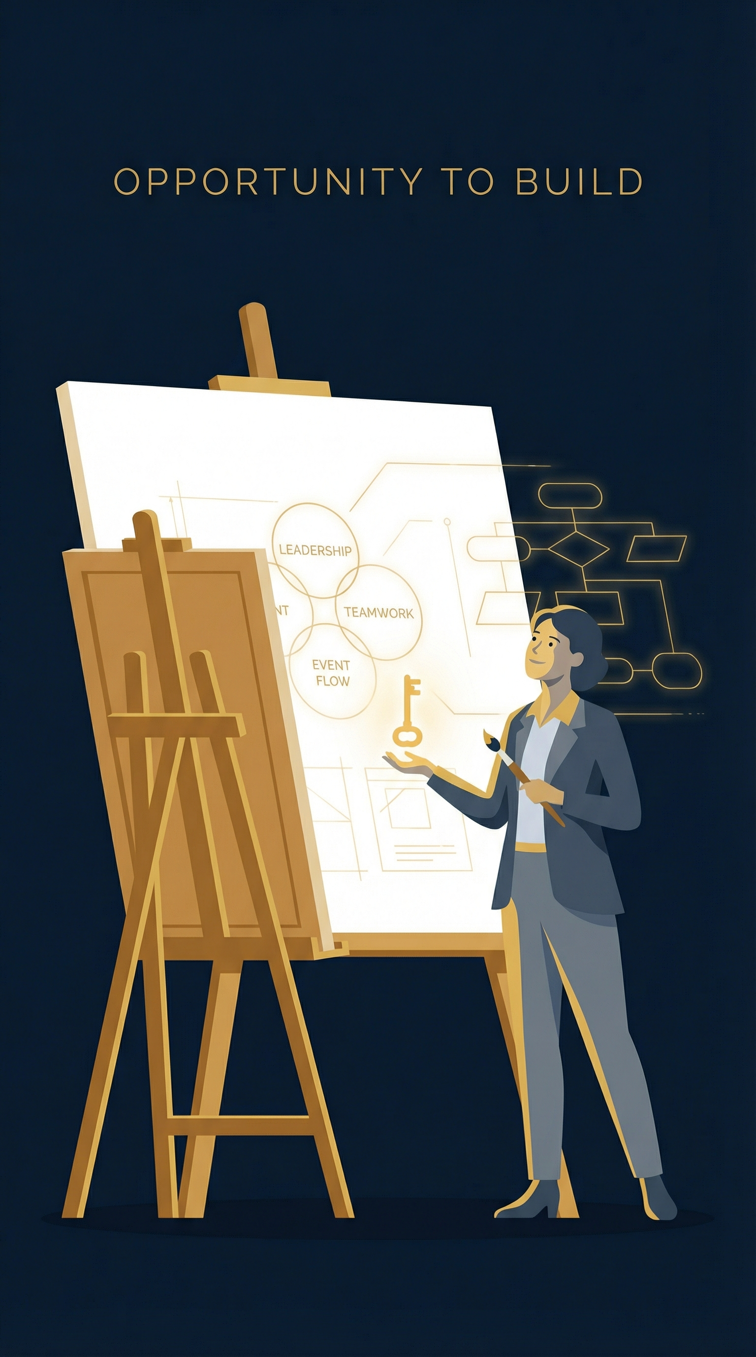
It started with a conversation
A shared vision, a mentor, and a plan
Dr. Clifford shared her ideas for a student leadership program. We brainstormed events, surveyed students, and shaped the workshops together based on real feedback.
With her guidance, I built it from the ground up.
2 / 17

Slide 3
Who Am I
From Classroom to Program Builder
🎓 Education
Curriculum · Pedagogy Assessment
🩺 Healthcare
Leadership · Clinical Community
● Bingjun Li — M.S.Ed. Graduate Assistant
● Assigned to SNHS under Dr. Clifford
● Tasked with building the Student Ambassador Program from concept to reality
● Education background meeting healthcare leadership — a unique intersection
Student Ambassador Program
Where education meets healthcare leadership
3 / 17

Slide 4
The Mission
What Is the Student Ambassador Program?
A one-year leadership development program for 20-30 SNHS undergraduate students who represent the school, lead health promotion initiatives, and grow as future healthcare leaders.
Transformational
Democratic
Adaptive
Collaborative
🎯
🤝
📈
🩺
Leadership Training
Community Outreach
Professional Development
Health Career Exposure
Workshops, styles, case studies
Healthy Futures, local schools
Public speaking, mentorship
Simulations, field trips
4 / 17

Slide 5




What I Built
Designing Everything from Scratch
Leadership Curriculum
Assessment Tools
Events & Workshops
Outreach Materials
Transformational, democratic, adaptive & collaborative leadership workshops with case studies
Leadership questionnaire & activity interest survey to measure growth and guide programming
2 leadership workshops, 2 ice breaker events, plus full Spring 2026 programming calendar
Healthy Futures flyer, program poster, promotional materials for recruitment & community partners
5 / 17

Slide 6
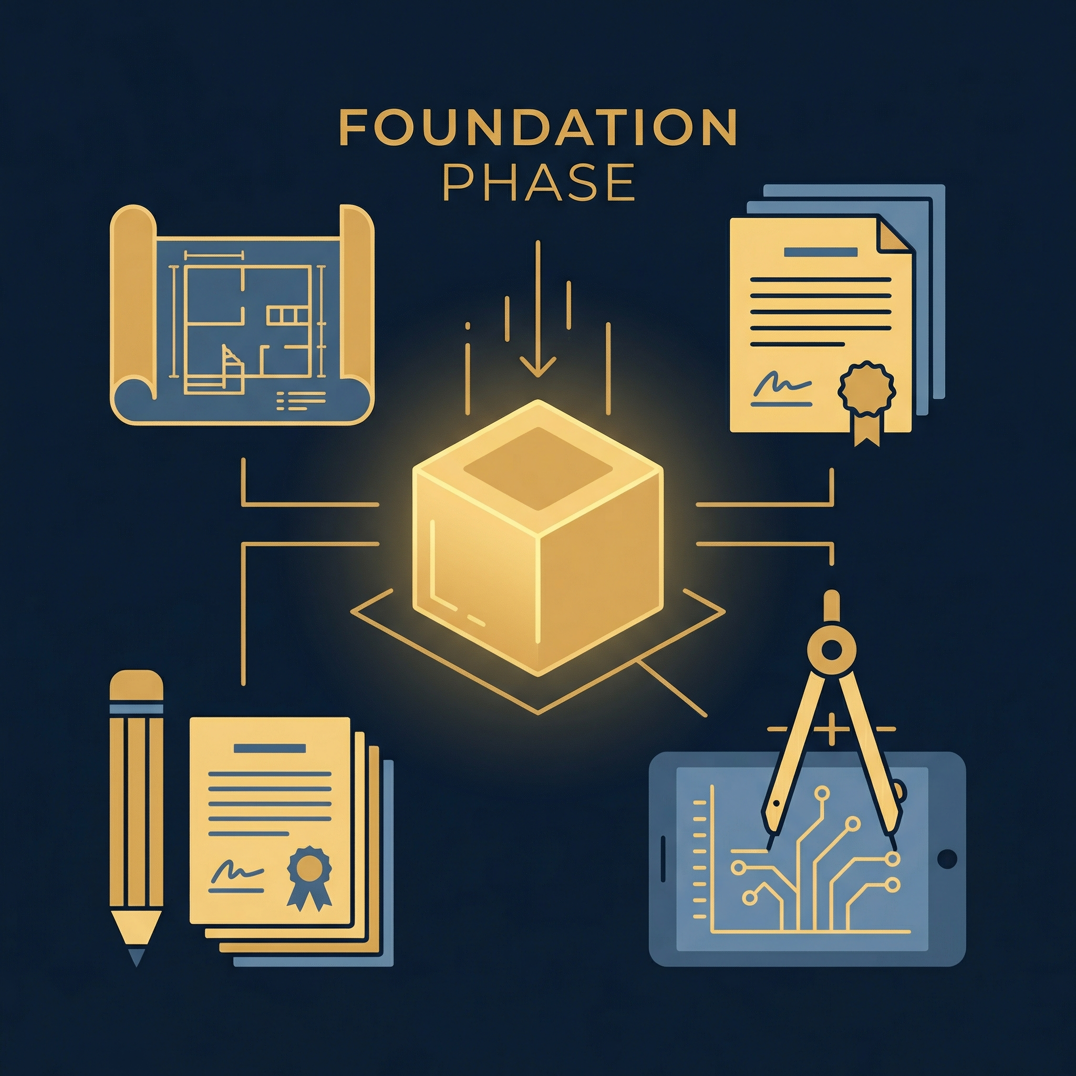

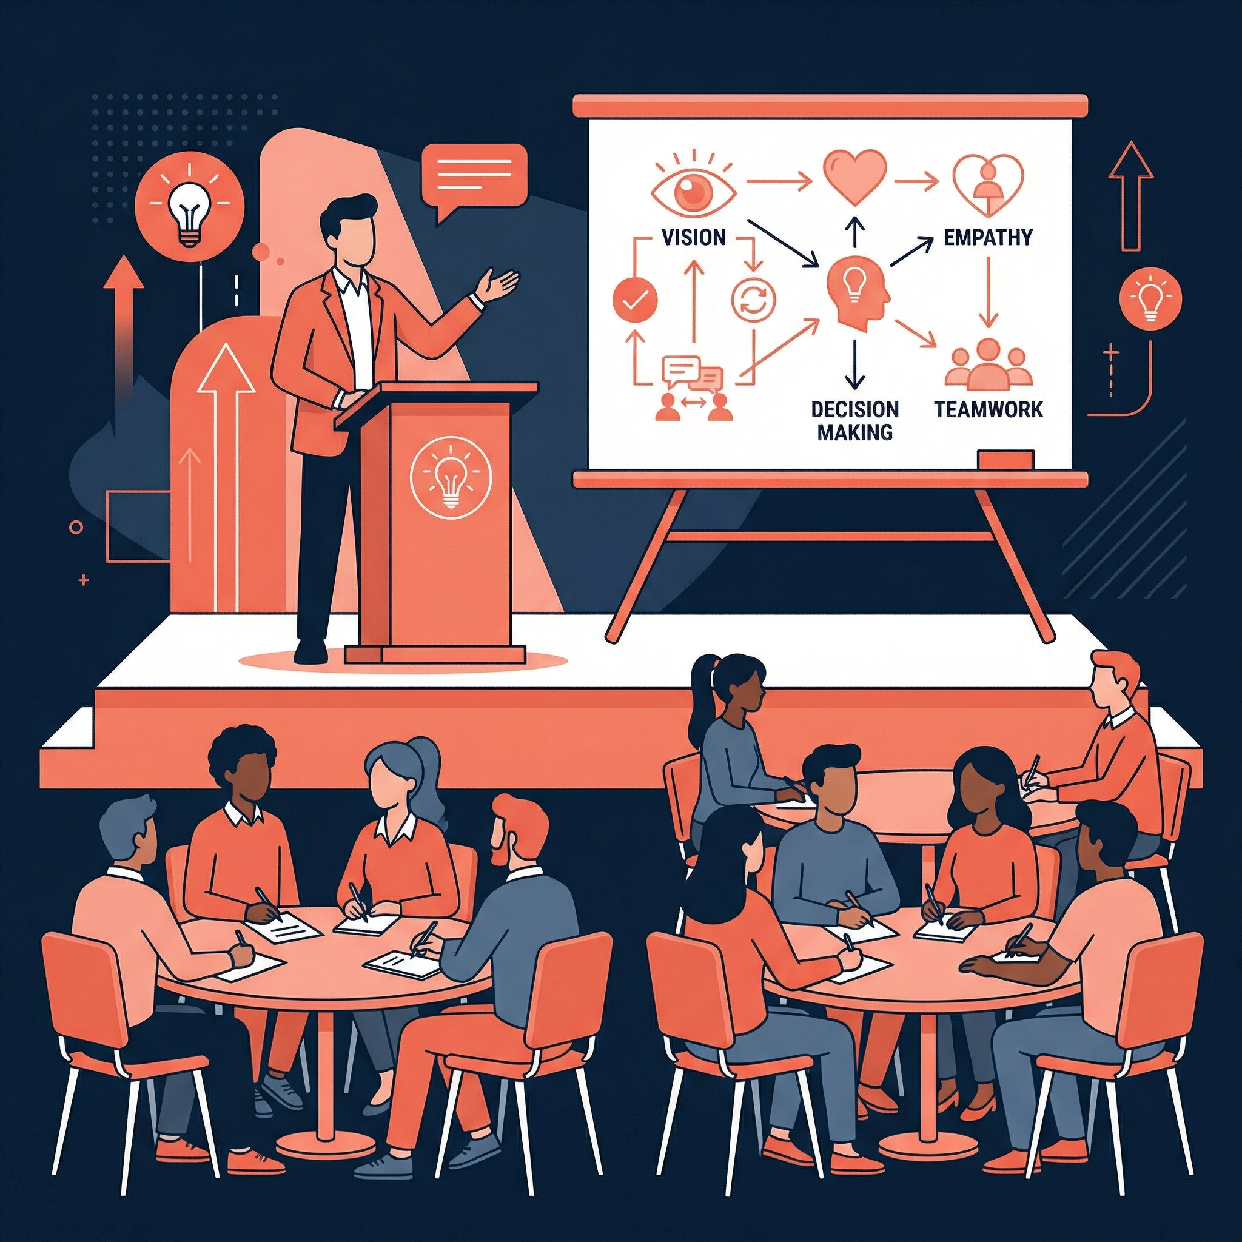
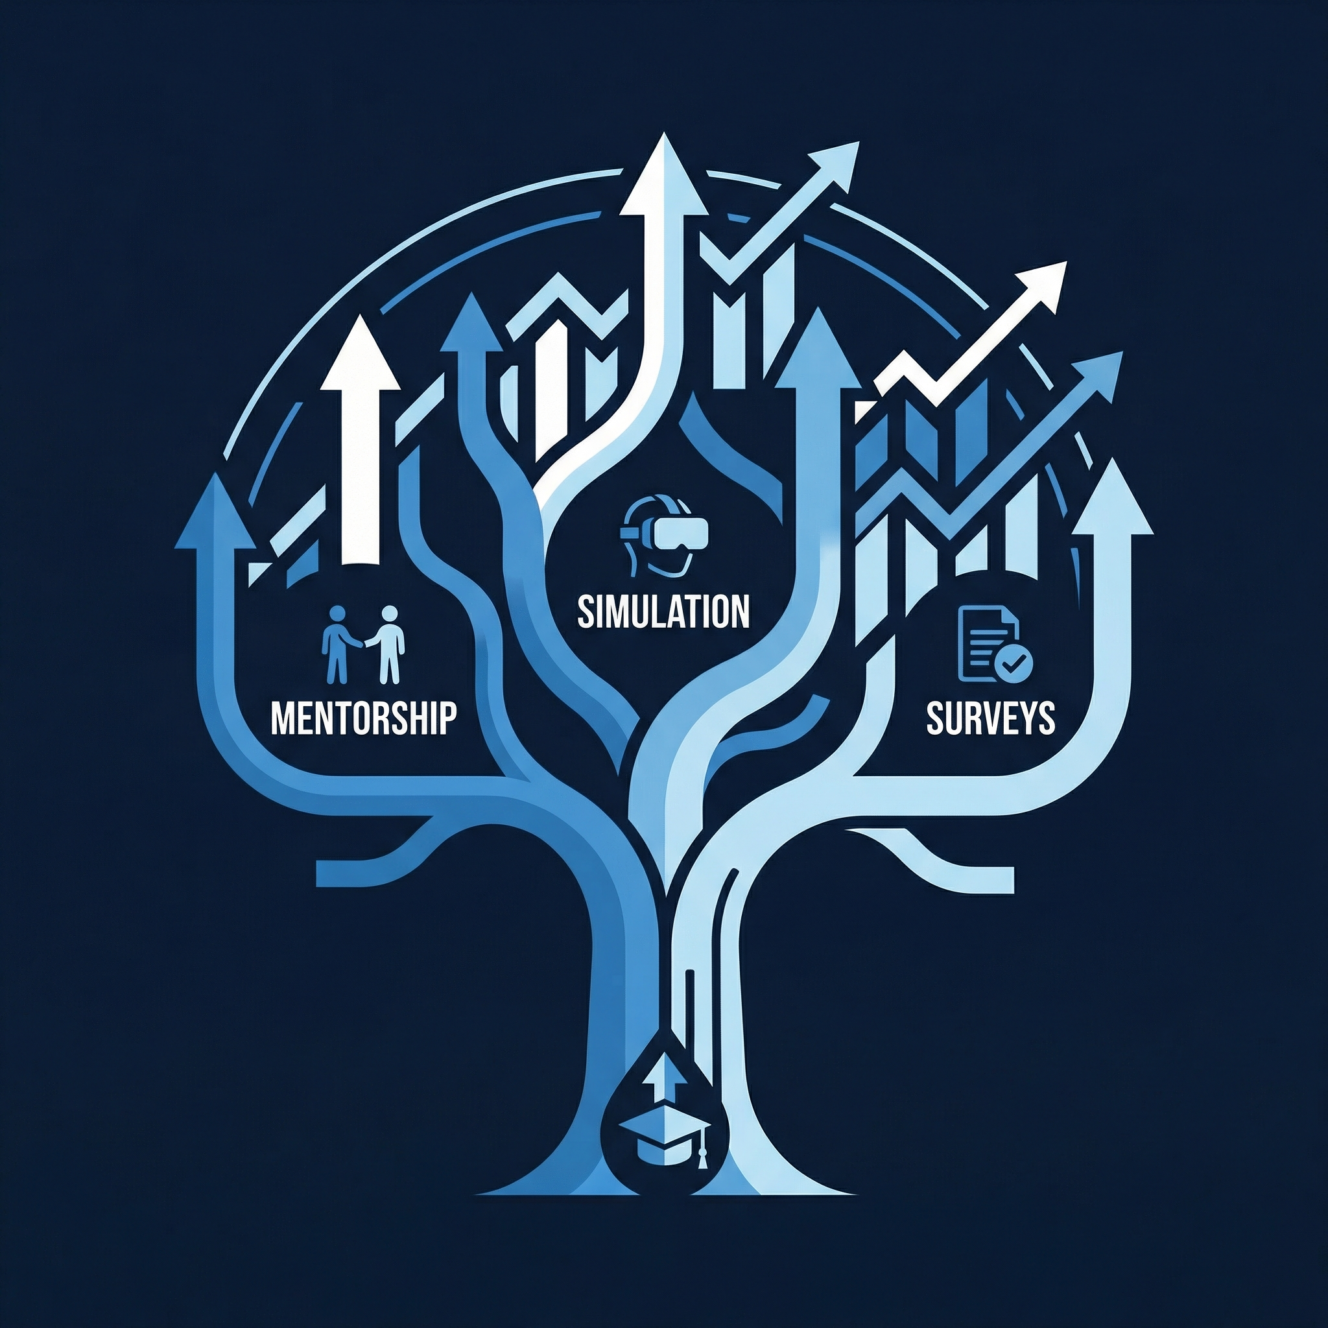

The Journey
Program Timeline
Foundation
Launch
Workshops
Growth
Future
Fall 2025
Nov 2025
Nov-Dec 2025
Spring 2026
2026+
Grant Secured Program Design Recruitment
Ice Breaker Events Team Building 20-30 Ambassadors
Leadership Training Transformational Leadership Focus
Simulation Field Trip Mentorship Training Interest Surveys
Community Outreach Leaders Symposium Healthy Futures
6 / 17

Slide 7

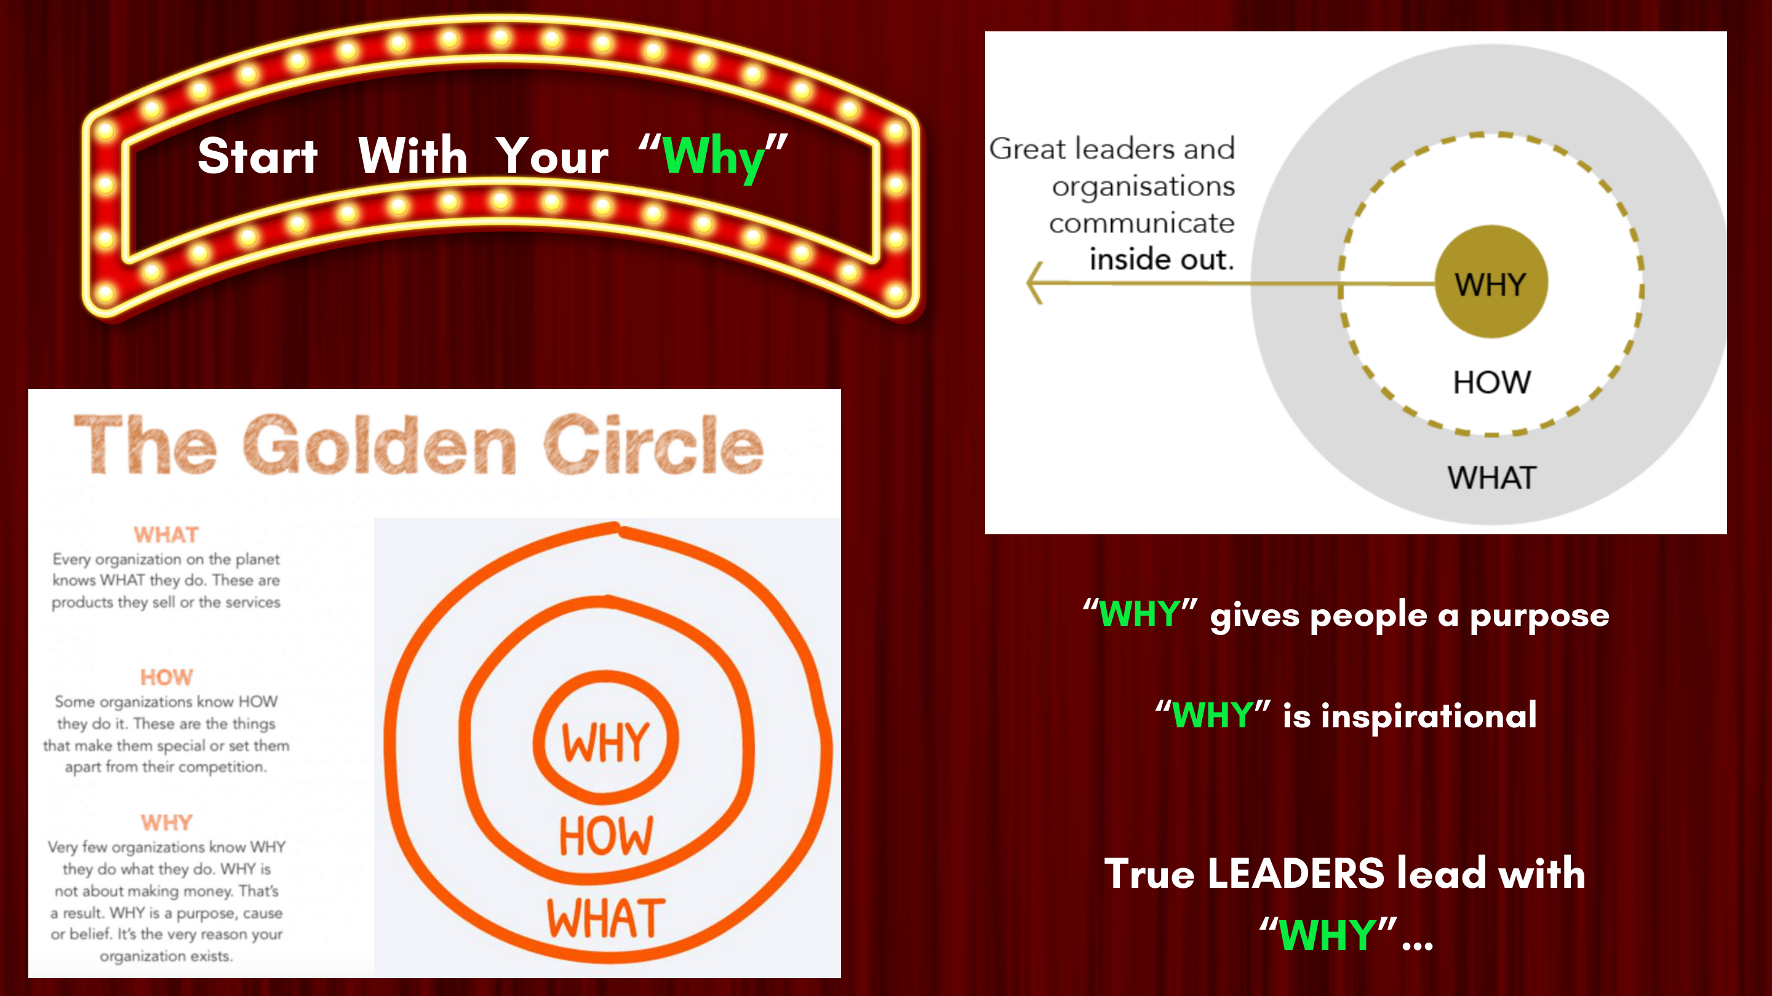
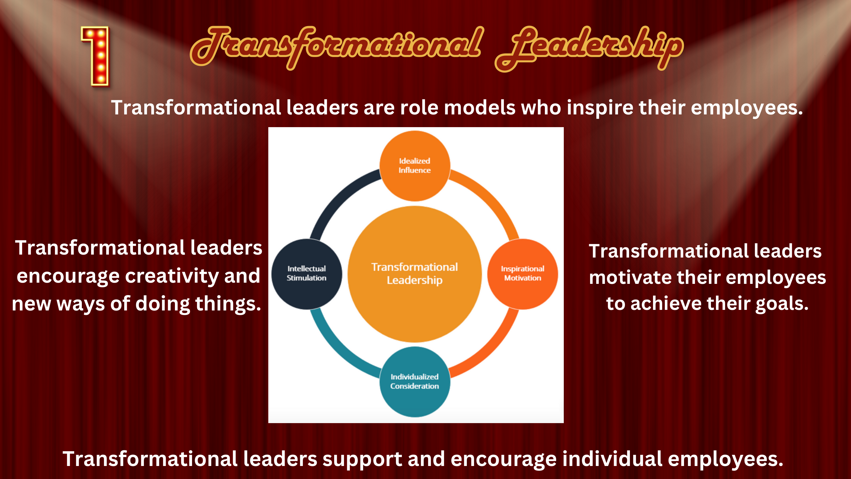

Workshop 1, November 18, 2025
Leadership & Communication Skills
My first workshop ever, designed from scratch. Introduced different leadership styles through real world case studies, group discussions, and interactive activities to build communication skills.
Actual slides from Workshop 1
7 / 17

Slide 8
My Growth as a Facilitator
What I Learned & Changed
After Workshop 1, I noticed...
So for Workshop 2, I...
📝 Too much content delivery, not enough student interaction
📊 Added a post-survey to capture feedback in real time
💬 Students wanted more discussion and real conversation
🤝 Shifted to discussion-driven format, less lecturing, more facilitating
⏱ Pacing felt rushed, needed to slow down and listen
🎓 Co-facilitated with Dr. Clifford, learned from watching her lead
Content Heavy
Listen first, then redesign
Student Centered
8 / 17

Slide 9



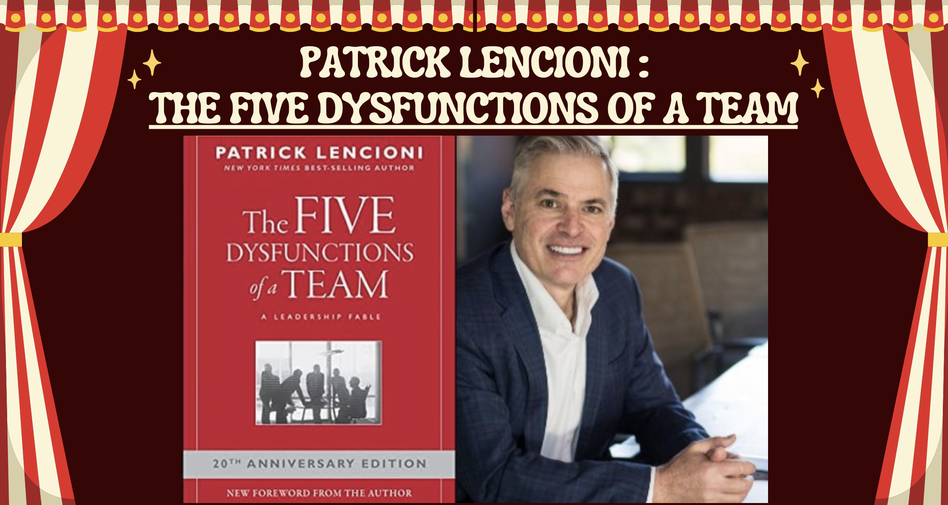
Workshop 2, December 2, 2025
Transformational Leadership
A redesigned, discussion-driven workshop. Started with Simon Sinek's "Start With Why", asked students to reflect on their own why, and explored team dynamics through Patrick Lencioni's Five Dysfunctions of a Team.
Actual slides from Workshop 2
9 / 17

Slide 10
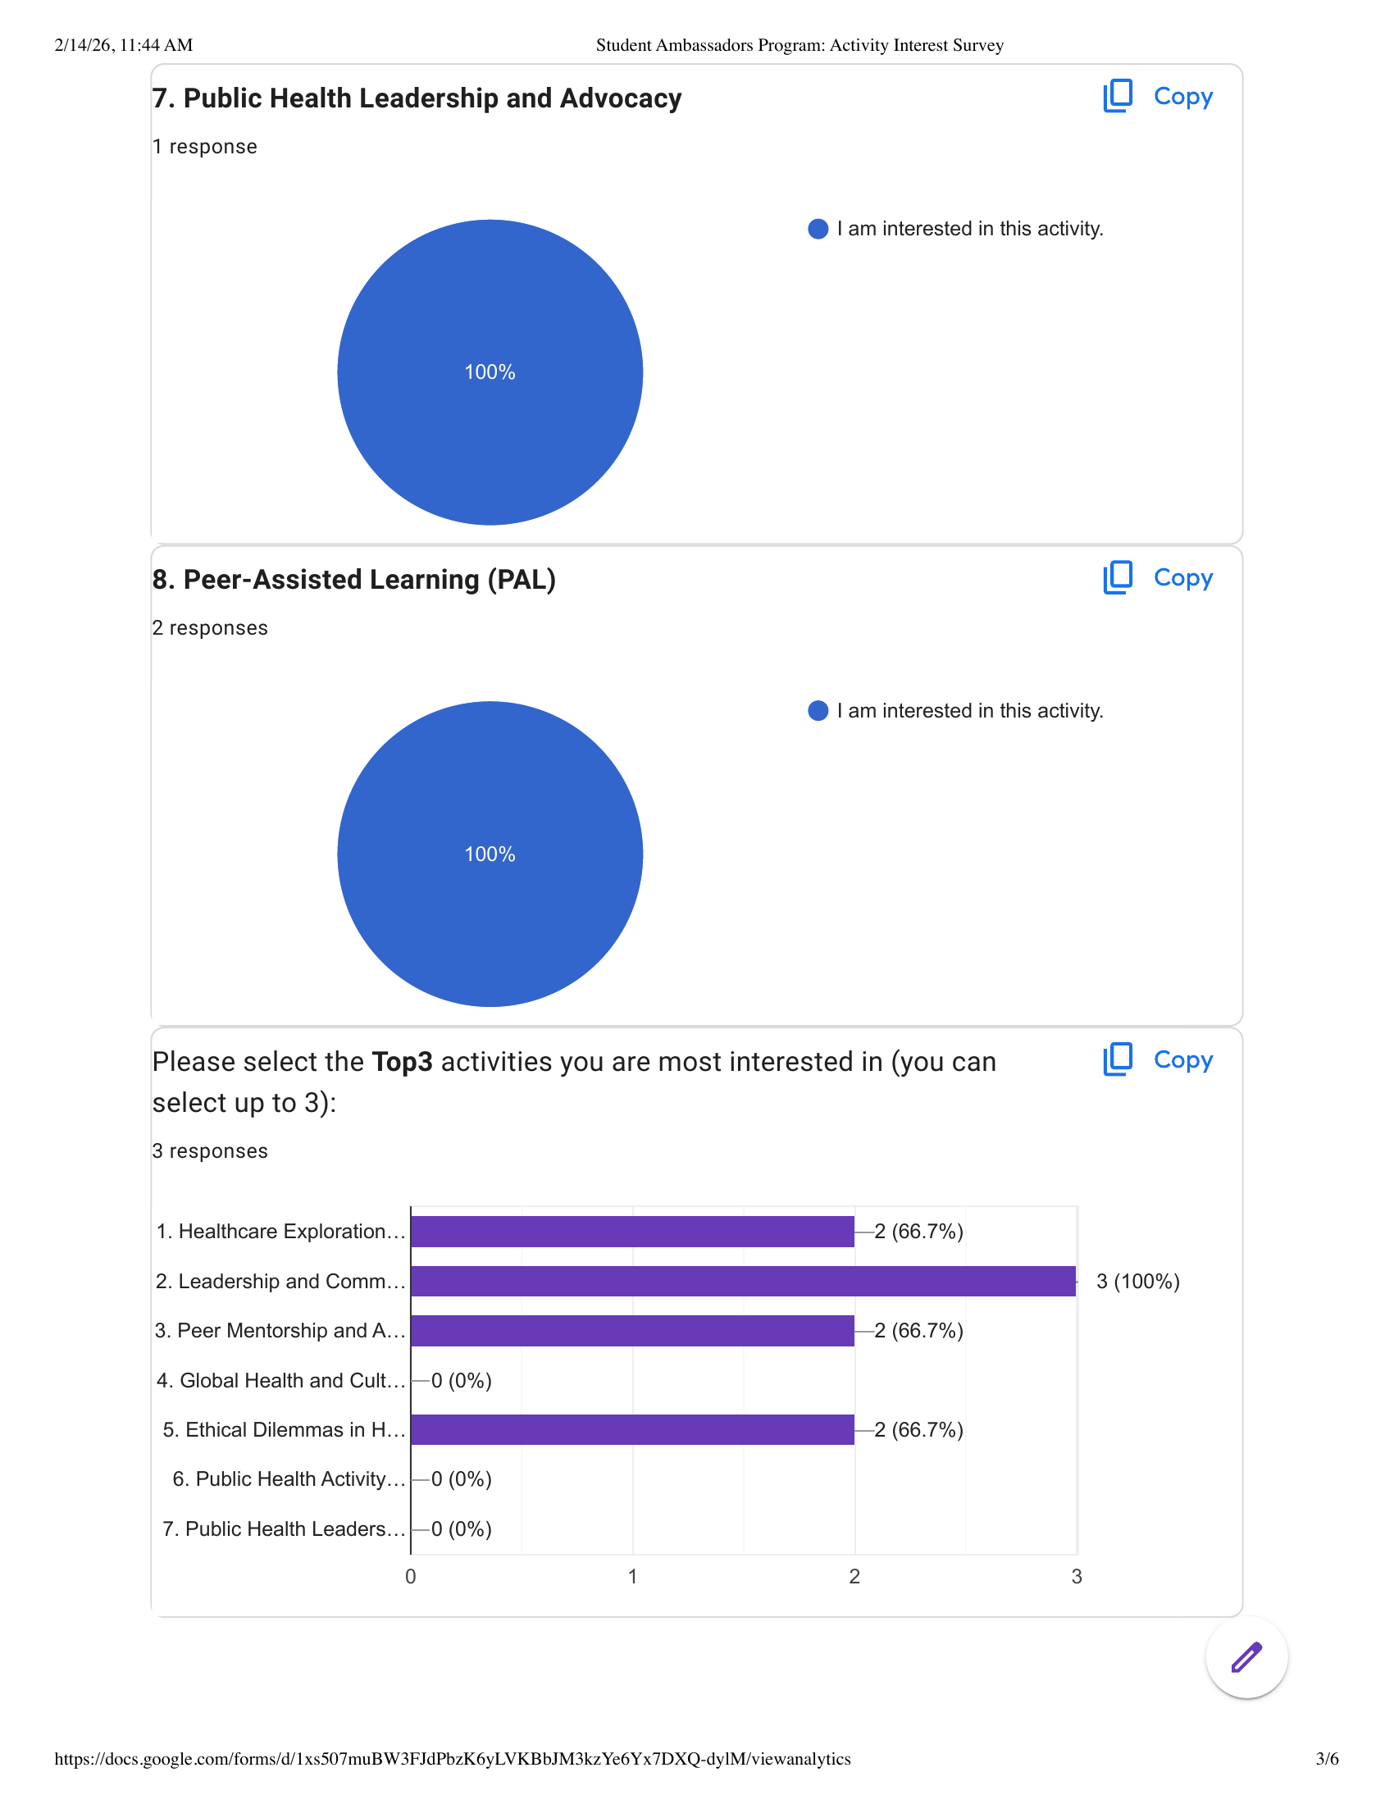
In Their Own Words
What the Ambassadors Said
"B did great! It was an effective way of hearing how I could actually be a good leader. Good to see a little bit of Dr. Clifford's personality too."
— Post-workshop survey response
"I really loved this activity that we did with the nursing ambassadors. I can't wait to see what future events has in store for us."
— Post-workshop survey response
"I would like to get a better communication style when working with a team... gain the confidence in public speaking and talking with families, faculty, potential students."
Activity Interest Survey Results (3 responses)
Leadership & Communication: 100% interest
— What students want from the program
Students want practical, interactive experiences
10 / 17

Slide 11

Real Talk
The Challenges Nobody Warns You About
Logistics & Coordination
Scheduling 20-30 busy undergrads, booking rooms, managing budgets, handling permissions — the invisible work that makes everything else possible.
Curriculum Design
How do you teach leadership to nursing and health students in a way that's practical, not theoretical? Finding the right balance was an ongoing experiment.
Topic Selection & Engagement
Which leadership styles matter most? How do you keep participation high? Every choice had to be intentional and student-centered.
11 / 17

Slide 12

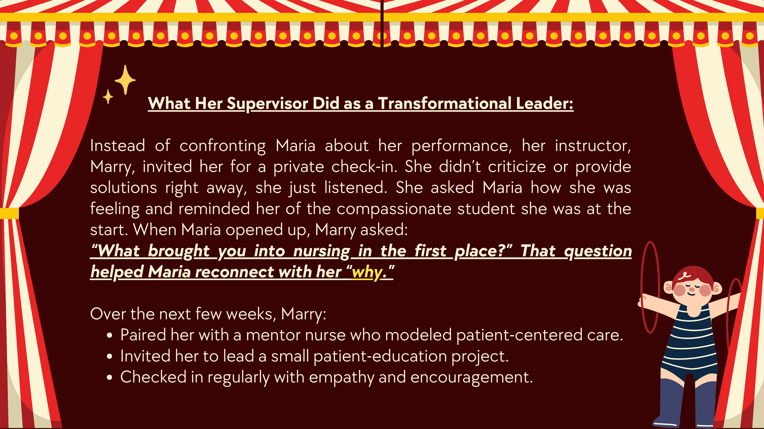

The Turning Point
The students were engaged from the start, in both workshops. What really changed was me. By the second workshop, I stopped anticipating their answers. I stopped planning how to respond before they finished speaking.
When It All Clicked
I learned to truly listen, to be present in the moment, and to let the conversation flow naturally instead of controlling it.
That shift made all the difference. I became more engaged, more curious, and more connected to the students I was serving.
Case study slides that sparked real debate
12 / 17

Slide 13
Impact So Far
By the Numbers
20
4
4
$10K
Undergraduate Ambassadors
Events Completed
Leadership Styles Taught
Diversity Innovation Grant Secured
Connected to the Healthy Futures Initiative, building pathways for underserved communities into health professions
13 / 17

Slide 14
Looking Ahead
Spring 2026 & Beyond
Program Design
Ice Breakers
● Simulation Field Trip — Grunin Center hands-on experience in Nursing, PA, OT, AT, PT
● Peer Mentorship Training — Building public speaking & mentorship skills
● Future Leaders Symposium — Full day mini-conference with certificates
● Community Outreach — Connecting with local schools through Healthy Futures
Workshops
Field Trips & Surveys
Symposium & Outreach
Program Growth Trajectory
14 / 17

Slide 15
Lessons Learned
What Building This Program Taught Me
Start With People
Iterate, Don't Perfect
Leadership Is Learned By Doing
Great programs aren't built on paper — they're built on relationships. Listen to your students first, design second.
The first workshop wasn't perfect. The second was better. Progress beats perfection every time.
I didn't just teach leadership — I had to practice it. Building this program was my own leadership lab.
15 / 17

Slide 16
Gratitude
Thank You
🎓
🏫
🤝
🏆
Dr. Clifford
SNHS Faculty & Staff
20 Student Ambassadors
Scholarship Week Committee
Acting Dean & Mentor For believing in the vision and guiding me every step
For the resources, support, and trust to build something new
For showing up, leaning in, and making this program come alive
For the opportunity to share this journey with you today
None of this would have been possible without each of you
16 / 17

Slide 17
The best way to learn leadership is to build something that matters.
Thank you for your time and support.
Bingjun Li, M.S.Ed.
Graduate Assistant · SNHS · Monmouth University
Mentored by Dr. Clifford, Acting Dean
17 / 17

